Slide 1
Software Analysis and Design (CS:3004)
State Diagram

Slide 2
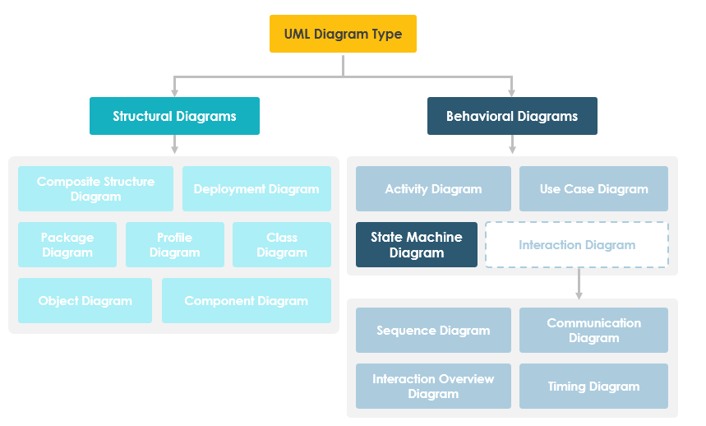
State diagram/State chart / State Machine Diagram:

Slide 3
State diagram/State chart / State Machine Diagram:
A state diagram is a technique that you can use to describe how your system behaves and responds.
When an event occurs, you note how a system acts or behaves.
State Machine Diagrams (or sometimes referred to as state diagram, state machine or state chart) show the different states of an entity
An object responds differently to the same event depending on what state it is in. State machine diagrams are usually applied to objects but can be applied to any element that has behavior to other entities such as: actors, use cases, methods, subsystems systems and etc.

Slide 4
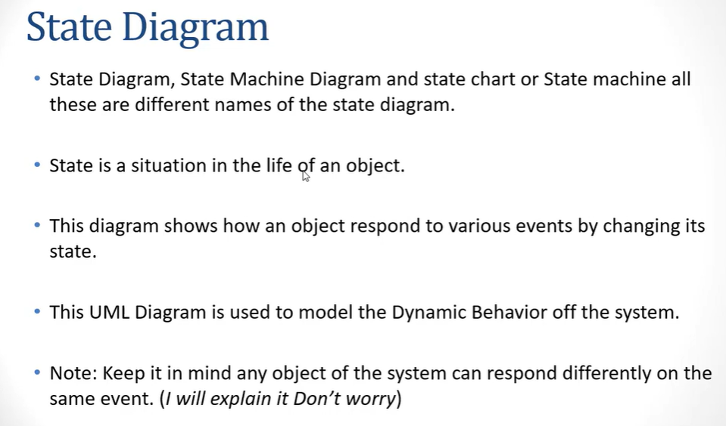

Slide 5
Note That:
A state machine diagram describes all events (and states and transitions for a single object)
A sequence diagram describes the events for a single interaction across all objects involved

Slide 6

State:
Let’s think of a person and to keep it simple, assume a person can have three emotional states.

Slide 7

State diagram
State diagrams can describe a single object and illustrate how that object behaves in response to a series of events in your system.
Think of an egg. What kind of states could an egg have?

Slide 8

Person’s emotional State change on some event happen:
dogsEatsYourbreakfast
MumRefuseToMakeAnotherOne

Slide 9
State:
A state is the way an object exists at a particular point in time. The state of an object is determined by the values of its attributes.
For example, think of a car.

Slide 10


Basic components of a state chart diagram:
Initial state – We use a black filled circle represent the initial state of a System or a class.
Transition – We use a solid arrow to represent the transition or change of control from one state to another. The arrow is labelled with the event which causes the change in state

Slide 11

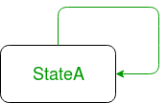
Continue…
State – We use a rounded rectangle to represent a state. A state represents the conditions or circumstances of an object of a class at an instant of time.
Self transition – We use a solid arrow pointing back to the state itself to represent a self transition. There might be scenarios when the state of the object does not change upon the occurrence of an event. We use self transitions to represent such cases.

Slide 12

termination
Termination represents an object being destroyed, or the process being completed, and is drawn as a circle with a filled circle inside.

Slide 13
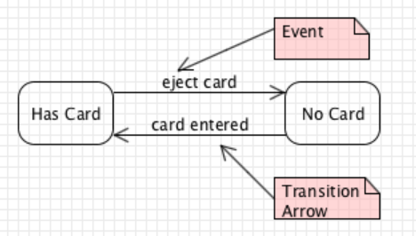

Slide 14
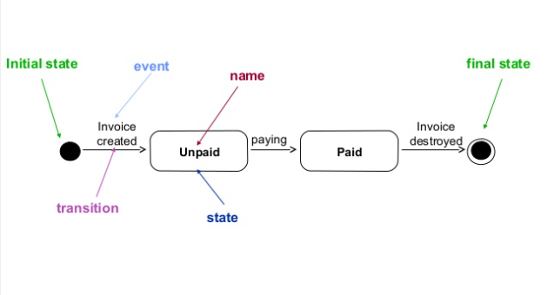
State Diagram Notation:

Slide 15
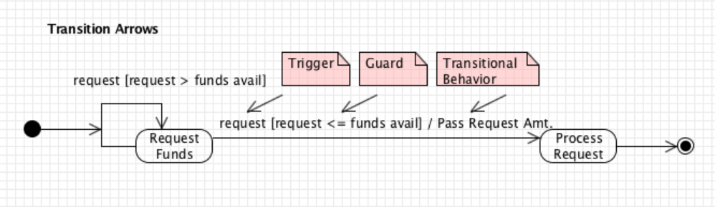

Slide 16
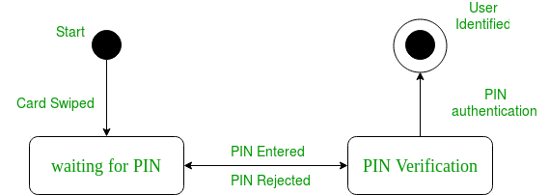
State Diagram- Depicting User Verification

Slide 17
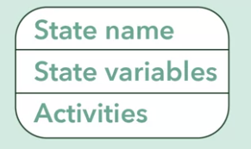
States in more detail:
Each state has three important sections,
a state name
state variables
and activities
Each state should at least have a state name.

Slide 18
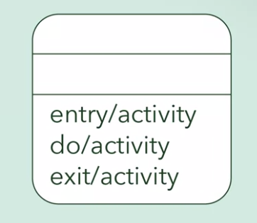
Continue…
Activities: are actions that are performed when in a certain state, and they're displayed at the bottom.
There are three types of activities for each state:
entry
exit
and do

Slide 19
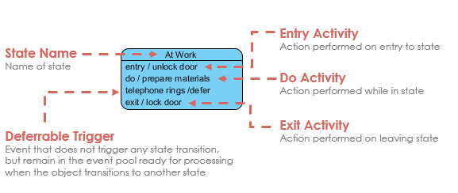

Slide 20
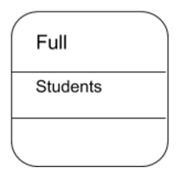
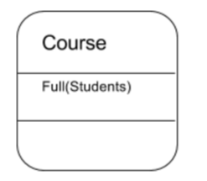
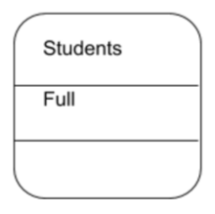
How would this course state of “Full” be expressed in a state diagram?
a
b
c

Slide 21
Entry activities: are actions that occur when the state is just entered from another state.
Exit activities: are actions that occur when the state is exited and
moves on to another state.
And do: activities are actions that occur once, or
multiple times while the object is in a certain state.

Slide 22
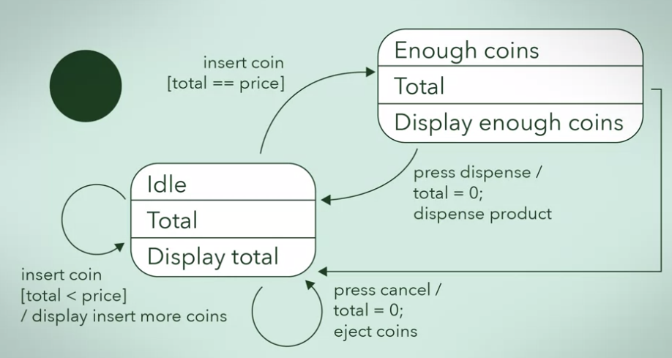
vending machine example

Slide 23
???
What is the purpose of a State diagram?
To show how data is manipulated and transferred within a system.
To show how a system or object behaves in reaction to events.
To show the different classes in a system.
To show how different classes interact with each other in a system.

Slide 24
Scenario:
The airplanes should go through multiple different states. When planes are not in use for a flight they are usually waiting to be assigned. Once a plane is chosen to be used for a flight, they are assigned to that flight until the airplane is ready for take-off. While the plane is in the air and flying the state is termed ‘en route’. Once the plane has reached its destination, the plane has to change into a state of landing for the airport to prepare for its arrival. Finally, once the plane has successfully landed, the plane is checked to see if it is ready to be assigned to a new flight or if maintenance is required. If maintenance is required the plane is unusable and if a mechanic decides that the plane cannot be repaired it is removed from the airport and disposed.

Slide 25
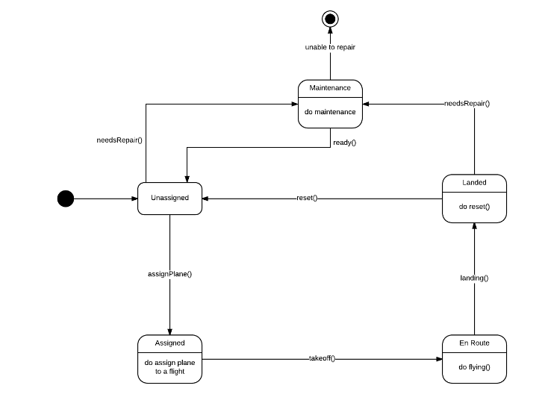

Slide 26
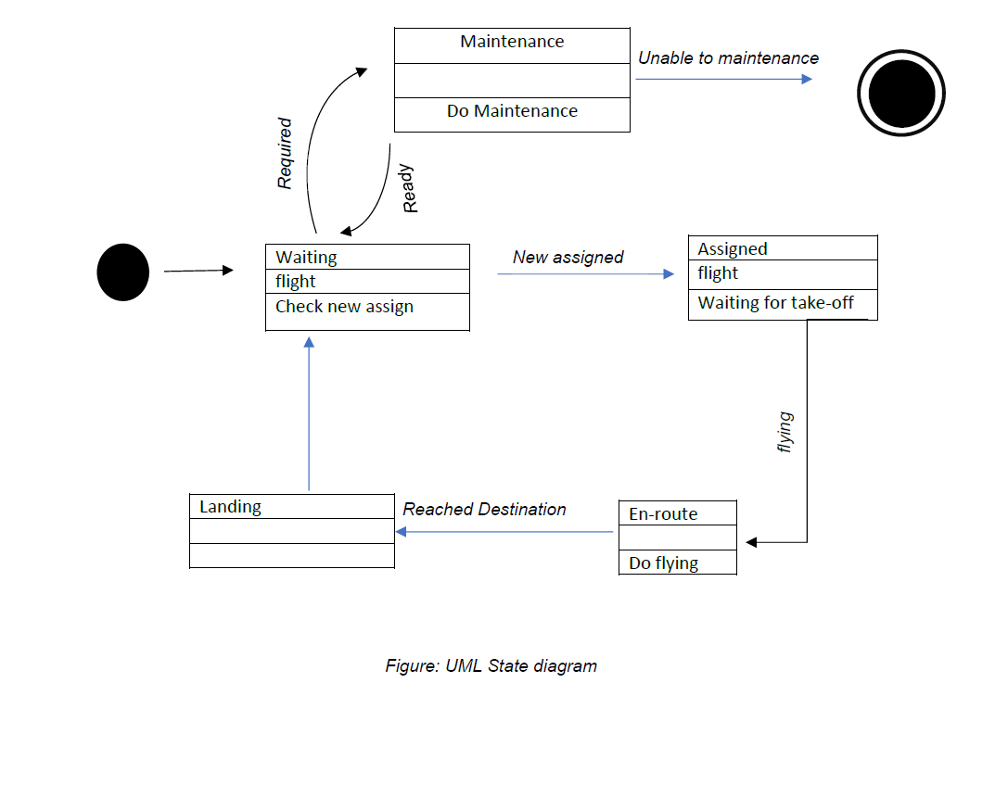

Slide 27
Simple state/Composite State
States two types (simple states or composite states)
simple states: A simple state is one which has no substructure
composite state is defined as state that has substates (nested states). Substates could be sequential (disjoint) or concurrent (orthogonal)
Substates may be nested to any level. A nested state machine may have at most one initial state and one final state. Substates are used to simplify complex flat state machines by showing that some states are only possible within a particular context (the enclosing state).

Slide 28
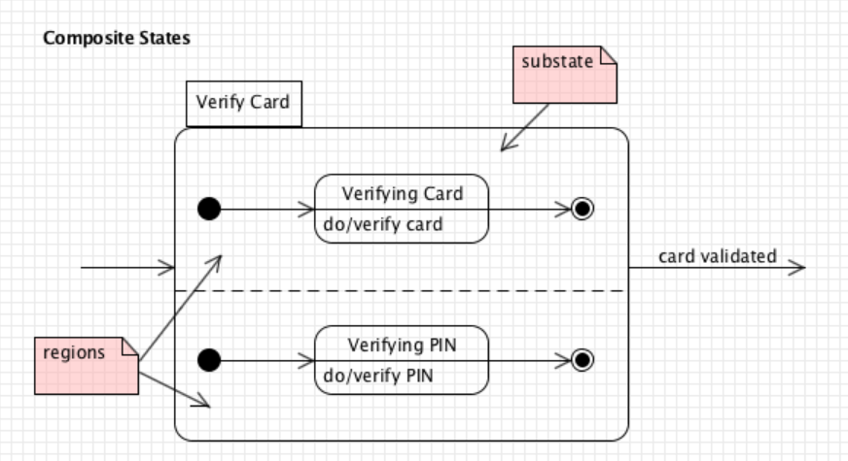
Substates/Composite State

Slide 29
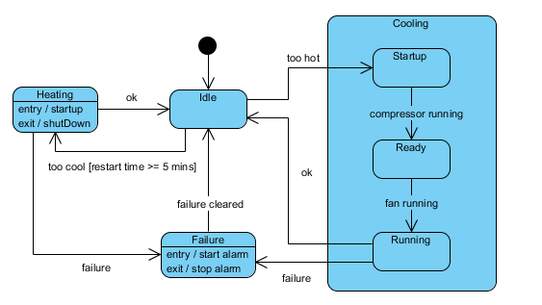
Substates/Composite State

Slide 30
Bank ATM UML State Machine Diagram Example
This is an example of UML behavioral state machine diagram showing Bank Automated Teller Machine (ATM) top level state machine.
ATM is initially turned off. After the power is turned on, ATM performs startup action and enters Self Test state. If the test fails, ATM goes into Out of Service state, otherwise there is triggerless transition to the Idle state. In this state ATM waits for customer interaction.
The ATM state changes from Idle to Serving Customer when the customer inserts banking or credit card in the ATM's card reader. On entering the Serving Customer state, the entry action readCard is performed. Note, that transition from Serving Customer state back to the Idle state could be triggered by cancel event as the customer could cancel transaction at any time.

Slide 31
Bank ATM UML State Machine Diagram Example
Serving Customer state is a composite state with sequential substates Customer Authentication, Selecting Transaction and Transaction. Customer Authentication and Transaction are composite states by themselves which is shown with hidden decomposition indicator icon. Serving Customer state has triggerless transition back to the Idle state after transaction is finished. The state also has exit action ejectCard which releases customer's card on leaving the state, no matter what caused the transition out of the state.

Slide 32
